Slide 1
Object Oriented Programming
Module 2(Part 1)
Prepared by Renetha J.B.
Prepared by Renetha J.B.
‹#›

Slide 2
Module 2
Polymorphism :- Method Overloading, Using Objects as Parameters, Returning Objects,
Recursion.
Static Members, Final Variables, Inner Classes.
Inheritance - Super Class, Sub Class, Types of Inheritance, The superkeyword, protected Members, Calling Order of Constructors.
Method Overriding, Dynamic Method Dispatch, Using final with Inheritance.
Prepared by Renetha J.B.
‹#›

Slide 3
Topics
Polymorphism
Method Overloading
Using Objects as Parameters
Prepared by Renetha J.B.
‹#›

Slide 4
Method Overloading
It is possible to define two or more methods with same name within the same class, but their parameter declarations should be different.
  This is called method overloading.
  This is a form of polymorphism (many forms)
Overloaded methods must differ in the type and/or number of their parameters. (return types is not significant.)
When an overloaded method is invoked, Java uses the type and/or number of arguments to determine which version of the overloaded method to actually call.
Prepared by Renetha J.B.
‹#›

Slide 5
// Demonstrate method overloading.
class Over
{
void test()
{
System.out.println(“Empty");
}
void test(int a) {
System.out.println("a: " + a);
}
void test(int a, int b) {
System.out.println(“a=”+a);
System.out.println(“b=”+b);
}
}
class Sample {
public static void main(String args[])
{
Over ob = new Over();
ob.test();
ob.test(10);
ob.test(2, 5);
}
}
OUTPUT
Empty
a=10
a=2
a=5
Prepared by Renetha J.B.
‹#›

Slide 6
In the example ,test( ) is overloaded three times.
  The first version test() takes no parameters,
  the second test(int a)takes one integer parameter
  the thrd test(int a,int b) takes two integer parameters.
Prepared by Renetha J.B.
‹#›

Slide 7
Method Overloading(contd.)
When an overloaded method is called, Java looks for a match between the arguments used to call the method and the method’s parameters
This match need not always be exact.
  In some cases, Java’s automatic type conversions can play a role in overload resolution.
Prepared by Renetha J.B.
‹#›

Slide 8
Overloading -through automatic type conversions
class Over{
void test() {
System.out.println(“Empty");
}
void test(double a)
{
System.out.println(“a: " + a);
}
}
class Sample {
public static void main(String args[])
{
Over ob = new Over();
ob.test();
ob.test(10);
ob.test(2.5);
}
}
OUTPUT
Empty
a=10
a=2.5
Prepared by Renetha J.B.
‹#›

Slide 9
Overloading -through automatic type conversions(contd.)
In this example when test( ) is called with an integer argument inside .
  Overload, no matching method is found with int as argument.
However, Java can automatically convert an integer into a double, and this conversion can be used to resolve the call.
  Therefore, when test(int) is not found, Java elevates int to double and then calls test(double).
Prepared by Renetha J.B.
‹#›

Slide 10
Overloading Constructors
Constructors can be overloaded. Because a class can have any number of constructors
  one default constructor, many parameterized constructors
class A
{
A() { //statements}
A(int a) { //statements}
A(int a,float b) { //statements}
}
Prepared by Renetha J.B.
‹#›

Slide 11
class Box
{
double width;
double length;
double height;
Box(double w, double l, double h)
{
width = w;
length = l;
height = h;
}
Box()
{
width = 0;
length =0;
height =0;
} }
class BoxDemo {
public static void main(String args[]) {
Box mybox1 = new Box();
Box mybox2 = new Box(3, 6, 2);
System.out.println("mybox1");
System.out.println(mybox1 .width + " “ +mybox1 .length + " "+ mybox1 .height);
System.out.println("mybox2");
System.out.println(mybox2.width + " “ + mybox2.length + " " + mybox2 .height);
} }
OUTPUT
mybox1
0.0 0.0 0.0
mybox2
3.0 6.0 2.0
Prepared by Renetha J.B.
‹#›

Slide 12
class Box
{
double width
double length;
double height;
Box(double w, double l, double h)
{
this.width = w;
this.length = l;
this.height = h;
}
}
class BoxDemo {
public static void main(String args[]) {
Box mybox1 = new Box(); //ERROR
Box mybox2 = new Box(3, 6, 2);
}
}
ERROR
Here following statement tries to create object mybox1 of class Box ,
Box mybox1 = new Box();
This should call default constructor Box() in class Box.
But Box class has constructor but no default constructor is there.
So ERROR occurs
Prepared by Renetha J.B.
‹#›

Slide 13
class Box
{
double width
double length;
double height;
}
class BoxDemo {
public static void main(String args[]) {
Box mybox1 = new Box();
}
}
NO ERROR in this code
The following statement creates object of Box class mybox1
Box mybox1 = new Box();
Since no constructors are not there,
Java provides the default constructor.
Prepared by Renetha J.B.
‹#›

Slide 14
Using Objects as Parameters
We can pas objects as arguments(parameters) to function(method).
Objects are passed by reference(call by reference).
Prepared by Renetha J.B.
‹#›

Slide 15
Object as parameters
class Test
{
int a, b;
Test(int i, int j)
  {
  a = i;
  b = j;
  }
boolean equals(Test ob)
{
if(ob.a == a && ob.b == b)
return true;
else return false;
}
}
class PassOb {
public static void main(String args[])
{
Test ob1 = new Test(100, 22);
Test ob2 = new Test(100, 22);
Test ob3 = new Test(-1, -1);
System.out.println(ob1.equals(ob2));
System.out.println(ob1.equals(ob3));
}}
OUTPUT
true
false
Prepared by Renetha J.B.
‹#›

Slide 16
Object as parameters
class Test {
int a, b;
Test(int i, int j)
{
a = i;
b = j;
}
boolean equals(Test o)
{
if(o.a == this.a && o.b == this.b)
return true;
else return false;
}
}
class PassOb {
public static void main(String args[])
{
Test ob1 = new Test(100, 22);
Test ob2 = new Test(100, 22);
Test ob3 = new Test(-1, -1);
System.out.println(ob1.equals(ob2));
System.out.println(ob1.equals(ob3));
}}
OUTPUT
true
false
Prepared by Renetha J.B.
‹#›

Slide 17
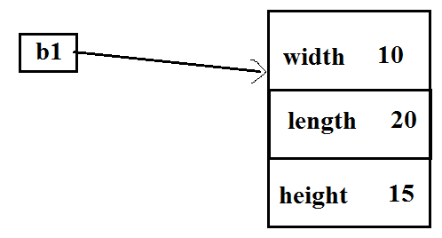
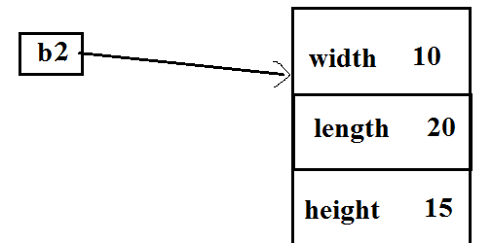
Object to initialize another object
class Box
{
double width
double length;
double height;
Box(double w, double l, double h)
{
width = w;
length = l;
height = h;
}
}
class BoxDemo {
public static void main(String args[])
{
Box b1 = new Box(10, 20, 15);
Box b2 = new Box(b1);
}
}
Here object b2 is a clone of b1.
The object b2 is initialized using
initial values of object b1
Prepared by Renetha J.B.
‹#›

Slide 18
Passing arguments to function
// Primitive types(int,char,double etc.) are passed by value.
// Objects are passed by reference.
Prepared by Renetha J.B.
‹#›

Slide 19
class Test {
int a;
Test(int i)
{
a = i;
}
void calc(Test o)
{
o.a *= 2;
}
void calc(int a)
{
a*=2;
}
}
class Obcall {
public static void main(String args[])
{
Test ob = new Test(15);
System.out.println("Object parameter");
System.out.println("Before call: " + ob.a );
ob.calc(ob); // //Call by reference
System.out.println("After call: " + ob.a );
int a=15;
System.out.println("Integer parameter");
System.out.println("Before call: " + a);
ob.calc(a); //Call by value
System.out.println("After call: " + a); } }
OUTPUT
Object parameter
Before call: 15
After call: 30
Integer parameter
Before call: 15
After call: 15
Prepared by Renetha J.B.
‹#›

Slide 20
Reference
Herbert Schildt, Java: The Complete Reference, 8/e, Tata McGraw Hill, 2011.
Prepared by Renetha J.B.
‹#›

